Slide 1




View in Power BI
Prepared By: Rajan Patel

Slide 2
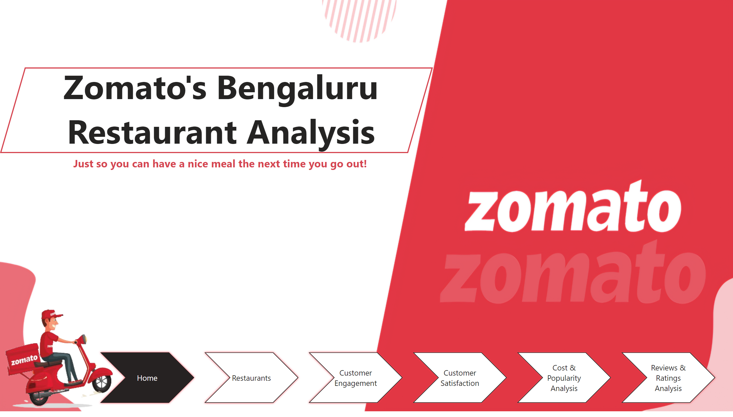
Home
Notes:
Zomato's Bengaluru Restaurant Analysis
No alt text provided
image
No alt text provided
pageNavigator
No alt text provided
textbox
No alt text provided
shape
No alt text provided

Slide 3
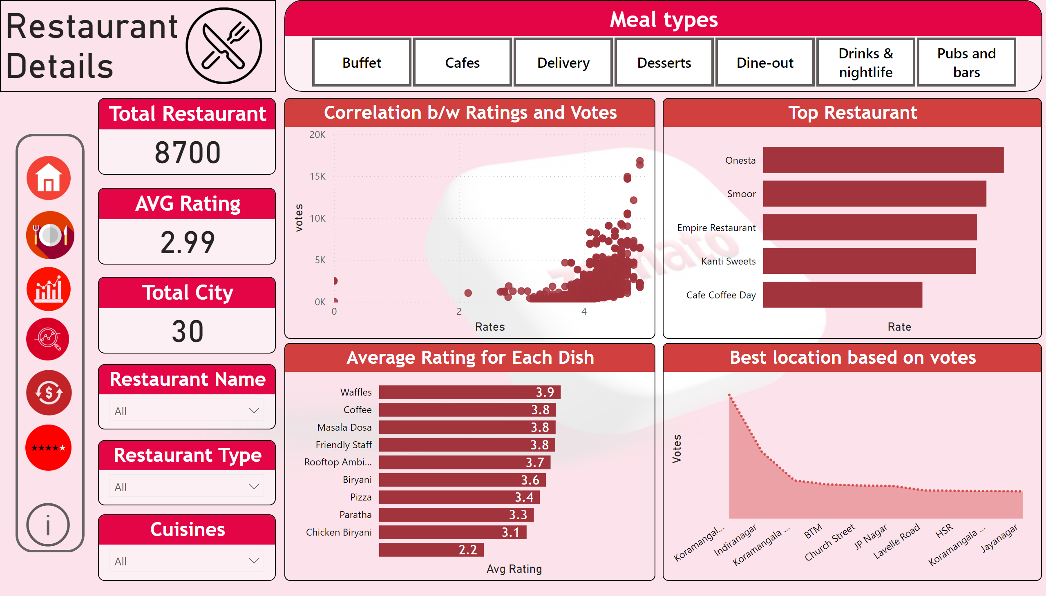
Restaurants
Notes:
textbox
No alt text provided
Total Restaurant
No alt text provided
Meal types
No alt text provided
image
No alt text provided
Top Restaurant
No alt text provided
Correlation b/w Ratings and Votes
No alt text provided
Average Rating for Each Dish
No alt text provided
AVG Rating
No alt text provided
Restaurant Name
No alt text provided
Total City
No alt text provided
Cuisines
No alt text provided
Restaurant Type
No alt text provided
Best location based on votes
No alt text provided
shape
No alt text provided
actionButton
No alt text provided
actionButton
No alt text provided
image
No alt text provided
image
No alt text provided
image
No alt text provided
image
No alt text provided
image
No alt text provided
image
No alt text provided
actionButton
No alt text provided

Slide 4
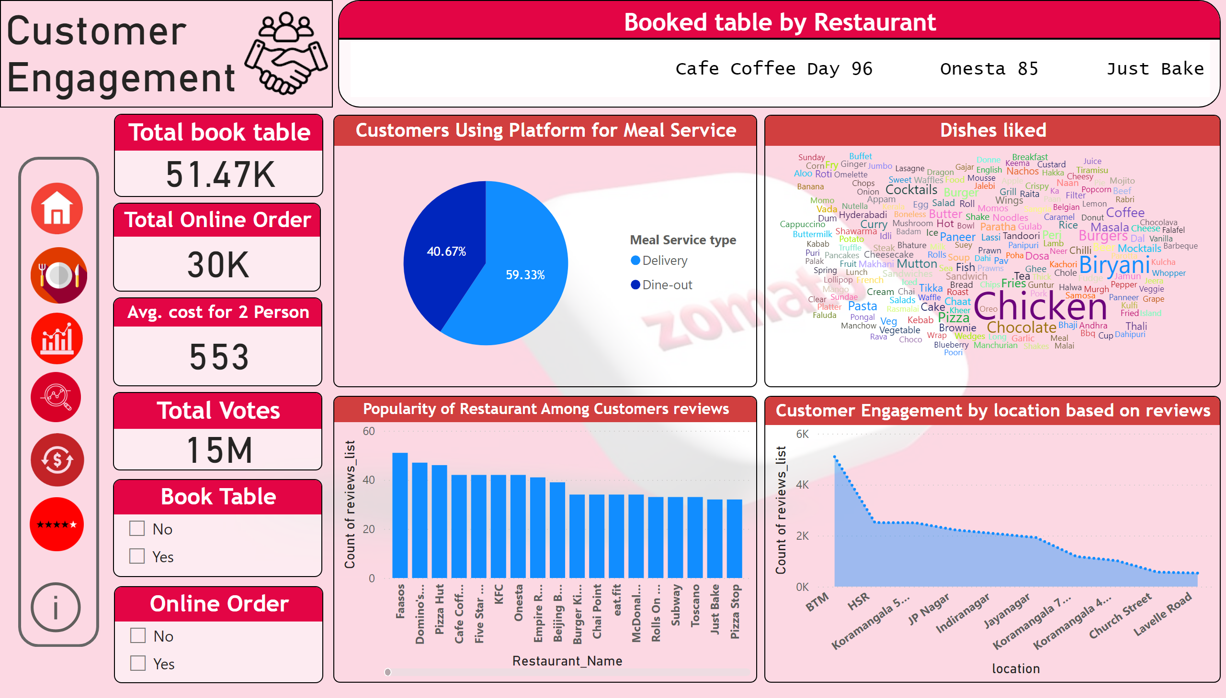
Customer Engagement
Notes:
textbox
No alt text provided
Total book table
No alt text provided
Avg. cost for 2 Person
No alt text provided
Book Table
No alt text provided
Online Order
No alt text provided
Customer Engagement by location based on reviews
No alt text provided
image
No alt text provided
Customers Using Platform for Meal Service
No alt text provided
Popularity of Restaurant Among Customers reviews
No alt text provided
Booked table by Restaurant
No alt text provided
Total Votes
No alt text provided
Dishes liked
No alt text provided
shape
No alt text provided
actionButton
No alt text provided
actionButton
No alt text provided
image
No alt text provided
image
No alt text provided
image
No alt text provided
image
No alt text provided
image
No alt text provided
image
No alt text provided
actionButton
No alt text provided
Total Online Order
No alt text provided

Slide 5
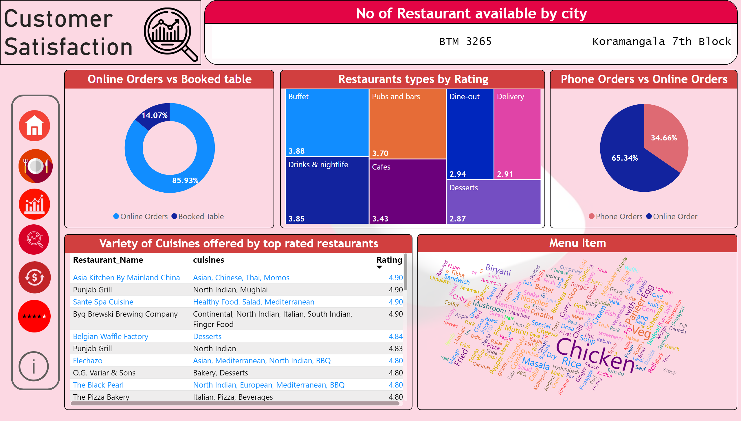
Customer Satisfaction
Notes:
textbox
No alt text provided
No of Restaurant available by city
No alt text provided
image
No alt text provided
Restaurants types by Rating
No alt text provided
Online Orders vs Booked table
No alt text provided
Phone Orders vs Online Orders
No alt text provided
Menu Item
No alt text provided
Variety of Cuisines offered by top rated restaurants
No alt text provided
actionButton
No alt text provided
actionButton
No alt text provided
shape
No alt text provided
actionButton
No alt text provided
actionButton
No alt text provided
image
No alt text provided
image
No alt text provided
image
No alt text provided
image
No alt text provided
image
No alt text provided
image
No alt text provided
actionButton
No alt text provided

Slide 6
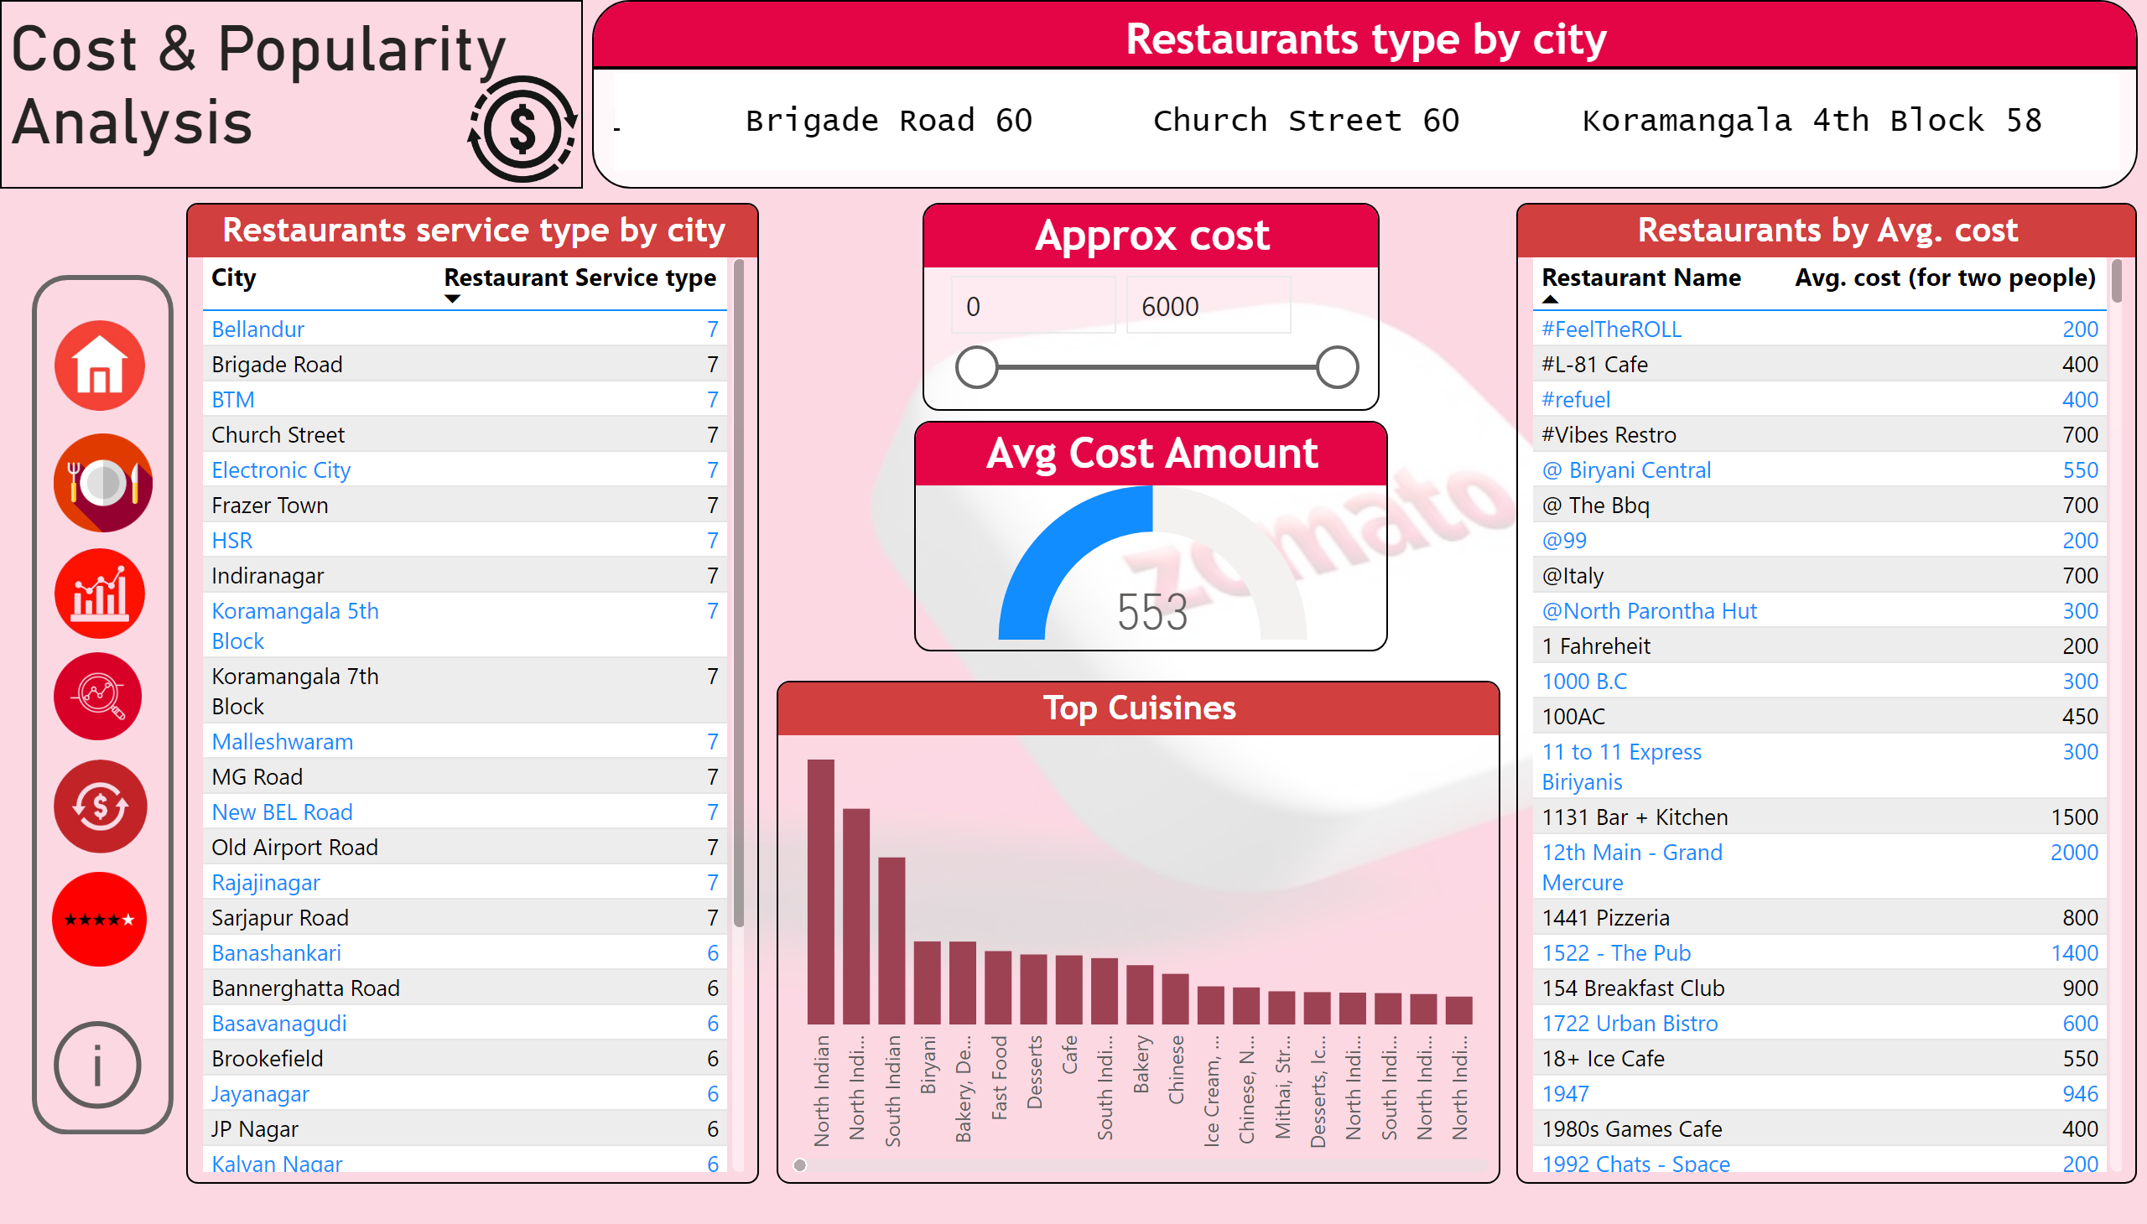
Cost & Popularity Analysis
Notes:
textbox
No alt text provided
Restaurants type by city
No alt text provided
Restaurants by Avg. cost
No alt text provided
Avg Cost Amount
No alt text provided
Top Cuisines
No alt text provided
Approx cost
No alt text provided
Restaurants service type by city
No alt text provided
shape
No alt text provided
actionButton
No alt text provided
actionButton
No alt text provided
image
No alt text provided
image
No alt text provided
image
No alt text provided
image
No alt text provided
image
No alt text provided
image
No alt text provided
actionButton
No alt text provided
image
No alt text provided

Slide 7
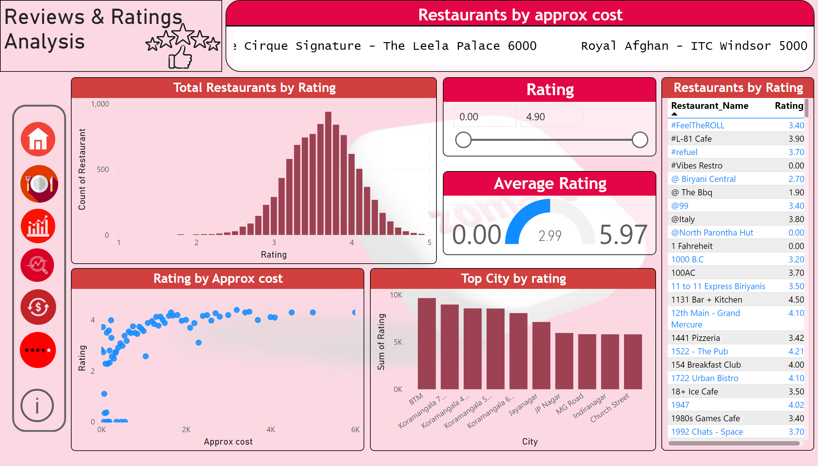
Reviews & Ratings Analysis
Notes:
textbox
No alt text provided
Restaurants by approx cost
No alt text provided
Total Restaurants by Rating
No alt text provided
Restaurants by Rating
No alt text provided
image
No alt text provided
Average Rating
No alt text provided
Top City by rating
No alt text provided
Rating by Approx cost
No alt text provided
Rating
No alt text provided
shape
No alt text provided
actionButton
No alt text provided
actionButton
No alt text provided
image
No alt text provided
image
No alt text provided
image
No alt text provided
image
No alt text provided
image
No alt text provided
image
No alt text provided
actionButton
No alt text provided

